Slide 1

Equational reasoning
The foundation of computing

Slide 2
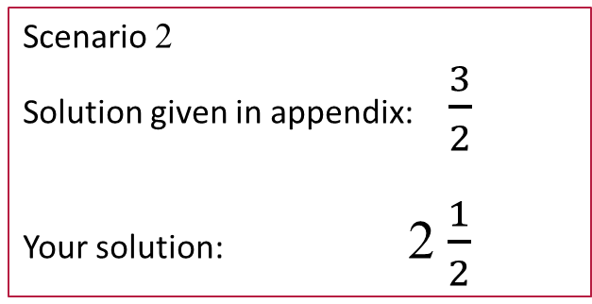
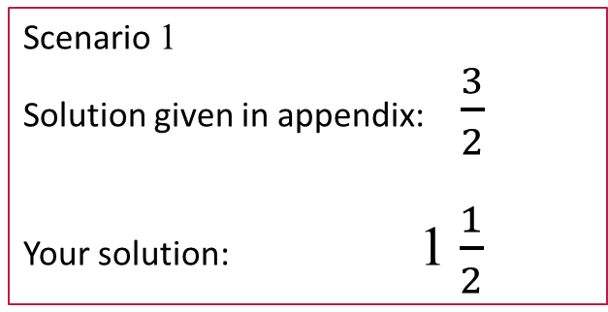
The word problem
Imagine you are doing homework for a math class. You solve a homework problem whose solution is given in the appendix. When comparing solutions you discover that your solution is not syntactically identical to the solution in the appendix. If we assume that the solution given in the appendix is correct, then what are you willing to conclude
about your solution?
Scenario 1
Solution given in appendix: $\frac{3}{2}$
Your solution: 1 $\frac{1}{2}$
Scenario 2
Solution given in appendix: $\frac{3}{2}$
Your solution: 2 $\frac{1}{2}$

Slide 3
The word problem is undecidable

Slide 4
concepts
Expression – also known as a term
Equation
Equational theory
Equivalence relation
Matching variables
Matching algorithm
Domain of discourse
Scope
Rewriting – also known as reduction, transformation, or simplification

Slide 5
Example 1
expression₁ = expression₂
lhs = rhs
x ∗ (y + z) = x ∗ y + x ∗ z

Slide 6
x ∗ (y + z) = x ∗ y + x ∗ z
5 ∗ (6 + 7)
→ 5 ∗ 6 + 5 ∗ 7
Do you understand the mechanics underlying this rewrite step?

Slide 7
The importance of understanding the mechanics underlying rewriting
Many people’s understanding of rewriting (and equational reasoning) is vague and “intuitive”.
Ideas underlying rewriting and equational reasoning provide the basis for a number of systems that are foundational to computer science.
Type systems
Operational semantics
Context-free grammars
An understanding that is vague and “intuitive” has difficulty dealing with syntactic shifts (e.g., the introduction of Greek symbols, etc.).

Slide 8

A game
We will try to describe (in pseudo formal terms) a general algorithm that can be used to apply a single rewrite step of the kind shown in an earlier slide.
This algorithm should capture your understanding of how equations can be used to rewrite expressions.
The algorithm is incorrect (unsound) with respect to your understanding if there exists a case (i.e., an expression) where it performs an incorrect rewriting step.
The algorithm is incomplete with respect to your understanding if there exists a case where you are able to perform a rewrite step which the algorithm cannot accomplish.

Slide 9
First pass
An equation is an equality involving two expressions.
We will use the term lhs/rhs to denote the expression on the left/right-hand side of the equals sign respectively. Abstractly then, an equation will have the following form.
lhs = rhs
Without loss of generality we will focus our attention on how the lhs of an equation can be used as the basis for a rewriting step.
A target expression is an expression that we want to rewrite.

Slide 10
Let t denote our target and let lhs = rhs denote an equation whose lhs will form the basis of a rewriting step.
Case 1. If t and lhs are syntactically identical, then the rewrite step t → rhs is possible.
1 + 0 = 1
1 + 0 → 1
Case 2. The expressions t and lhs are not syntactically identical, but the lhs contains variables which can be instantiated in such a way that the instantiated form of the lhs is syntactically identical to t.
x + 0 = x
1 + 0 → 1

Slide 11
substitution
We will use the concept of substitution to explicitly capture the variable instantiations used in a rewrite step.
In concrete terms, we will model a substitution as a concatenation of zero or more entries, where an entry is a binding that has the form [ variable := instantiation ].
Conceptually, we will think of a substitution as a function that can be applied to an expression.
We will use the symbol σ (sigma) to denote an arbitrary substitution.
We will use [] to denote the left/right identity element on substitutions.

Slide 12
Example Substitutions
Let σ = [ x := 2 ] – the substitution σ captures the idea that the variable x is to be instantiated by the integer 2
Let σ = [ x := 2 ] [ y := 3 ] – this substitution specifies that the variable x is to be instantiated by the integer 2 and the variable y is to be instantiated by the variable 3.
We will refer to an identifier that can be instantiated through substitution as a matching variable.

Slide 13
Properties of substitutions
Right identity. σ [] = σ
Left identity. [] σ = σ
[ x := 2 ][] can be simplified to [ x := 2 ]
[ x := 2 ][] → [ x := 2 ]
[][ x := 2 ][ x := 3 ] → [ x := 2 ][ x := 3 ]

Slide 14
Applying a substitution
The goal of applying a substitution is to replace matching variables with their instantiations.
We will treat substitutions as functions that can be applied to expressions.
Conceptually, a substitution applies its instantiations wherever and whenever it can.
We assume we know (informally) how to apply substitutions, but will leave unspecified the technical details of how such applications are actually performed.

Slide 15
Substitution Examples
Substitution | Expression | Application | Result
σ = [ x := 2 ] | 5 | σ(5) | 5
σ = [ x := 2 ] | x + 0 | σ(x + 0) | 2 + 0
σ = [ x := 3 ] | x + x | σ(x + x) | 3 + 3
σ = [ x := 3 ] [ y := 4 ] | x ∗ y + x | σ(x ∗ y + x) | 3 ∗ 4 + 3
σ = [ x := 3 ] [ y := 4 ] | x ∗ (y + z) | σ(x ∗ (y + z)) | 3 ∗ (4 + z)

Slide 16
Our algorithm: Attempt #1
Given an equation, lhs = rhs, and a target expression t.
If possible, discover a substitution σ such that σ( lhs ) and t are syntactically identical.
Given σ, perform the following rewrite.
t → σ(rhs)
Are we ready to bring in our Martian?

Slide 17
[ x := ? ]
Over what domain are matching variables quantified?
(2 + 3) * (6 + 7)
Now that this issue has been clarified are we ready to again bring in our Martian?

Slide 18
Attempt #2
5 ∗ ( 6 + 7 + 8 ) → ?

Slide 19
5 ∗ ( 6 + 7 + 8 ) → ?
Solution 1. The domain over which matching variables are quantified are expressions in PNF form.
A pre/post processing step is needed to insert/remove parenthesis – at least partially.
Solution 2. The expressions we are dealing with are trees (e.g., they have structure) not strings.
5 ∗ ( (6 + 7 ) + 8 ) → ?
σ = [x := 5 ][y := (6 + 7) ][z := 8 ]
σ = [x := … ][y := ][z := … ]
+
6
7
Now that this issue has been addressed are we ready to again bring in our Martian?

Slide 20
Attempt #3
y ∗ ( 6 + 7 ) → ?

Slide 21
y ∗ ( 6 + 7 ) → ?
In this example, y is an identifier that occurs in the target expression.
This y is not the same y that occurs in the equation whose lhs we are attempting to match.
The algorithm we are developing is a matching algorithm in which matching variables are only permitted to occur in equations. More specifically, matching variables may not occur in target expressions.
The scope of a matching variable extends over the equation in which it occurs (and not further).
This example introduces some low-level issues and constraints affecting the representation and application of substitutions.

Slide 22

“What's in a name? that which we call a rose
By any other name would smell as sweet;”
- William Shakespeare
Romeo and Juliet, Act II Scene II
In general, Shakespeare was wrong – names influence thought. Recall the choice of the word “smashed” versus “bumped” in the Brain Games video.
With respect to the restructuring information formally embodied within an equation, Shakespeare was right.

Slide 23
Alpha conversion
α conversion – a term from the λ-calculus capturing the idea that, within a given scope, a variable may be consistently renamed to a new (i.e., unique) variable without changing the functionality of the λ-expression.
In Java, the formal parameters of a method may be renamed provided the renaming is unique and consistently applied. Such renaming will not change the functionality of the method.
In general, any identifier (even method names) in a Java program can be α-converted.
α conversion is a capability provided by all code refactoring tools. Such renaming assumes the name resolution problem has been solved, which we have seen can be quite tricky in Java.

Slide 24
Assumptions and Conventions
Assumption
In equations (and expressions) we are able to syntactically distinguish matching variables (e.g., x, y, and z) from symbolic constants (e.g., a, b, and c).
Convention
We will α-convert equations prior to considering their use in a rewrite step.
Now that this issue has been addressed are we ready to again bring in our Martian?

Slide 25
Attempt #4
4 + 5 ∗ ( 6 + 7 ) → ?

Slide 26
subexpressions
Provided precedence and associativity rules are preserved, any subexpression of an expression can be the target of a rewriting step.
We will write e[t] to denote that t is a subexpression of e.
Note that t may be e.

Slide 27
summary
Given an equation, lhs = rhs, and an expression e.
Respecting precedence and associativity conventions, add parentheses to e as needed.
Select an expression t such that e[t]. Designate t as the target expression.
Perform α-conversion on the equation “lhs = rhs” to resolve naming conflicts.
Discover a substitution σ such that σ(lhs) and t are syntactically identical.
If such a σ can be found, then rewrite t within the context e[t] as follows; otherwise leave t unchanged.
e[t] → e[σ(rhs)]

Slide 28
Aside
Prolog is a language in which rewrite steps are understood from the perspective of logic.
Equation-like entities are expressed as restricted forms of logical implication called Horn clauses.
Target expressions are predicates called goals.
The Prolog equivalent of a rewrite step is called a resolution step.
Prolog uses a more powerful (and more complex) algorithm for matching, called unification.
Every resolution step is preceded by an α-conversion of the Horn clause used in that step.

Slide 29
The end

